Slide 1
YUMMY MEALS
Welcome to yummymeals

Slide 2
content
Yummy Meals
Content
Main Purpose
Minimal Requirements
Package Requirements
Structure
ER Diagram
Downloading from API
Filling db
Users
Users Preprocessing
Meals
Meals Preprocessing
Admin Panel
Chat
Errors
Index
Mail

Slide 3
Main functionalities
Having a Website supporting
.User authorization block (Registration)
.Admin block
.User account block
.Searchbox block
.Favorite recipes block /categories block
.Comments block
.Chat block
.Notifications with email
.Add a receipt
Return to content

Slide 4
Minimal requirements
Download from API
Saving into database
Demostrate webpage
Return to content

Slide 5
Package requirements
Flask_Admin
itsdangerous
WTForms
gevent
SQLAlchemy
flask_paginate
schedule
Flask_Mail
Flask_WTF
Flask_Login
requests
pandas
Flask_SocketIO
Flask_SQLAlchemy
Flask_Bcrypt
Flask_Script
alembic
Flask_Migrate
Pillow
secrets
Return to content

Slide 6
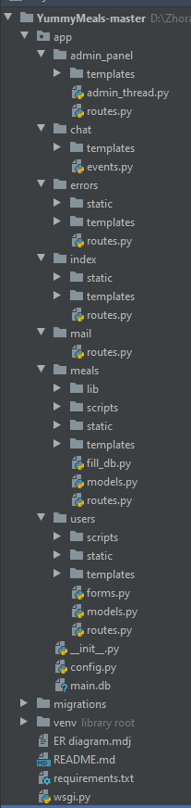
STRUCTURE
YummyMeals
app
admin_panel
chat
errors
index
mail
meals
users
migrations
WSGI run
__init__.py
main.db
Return to content

Slide 7
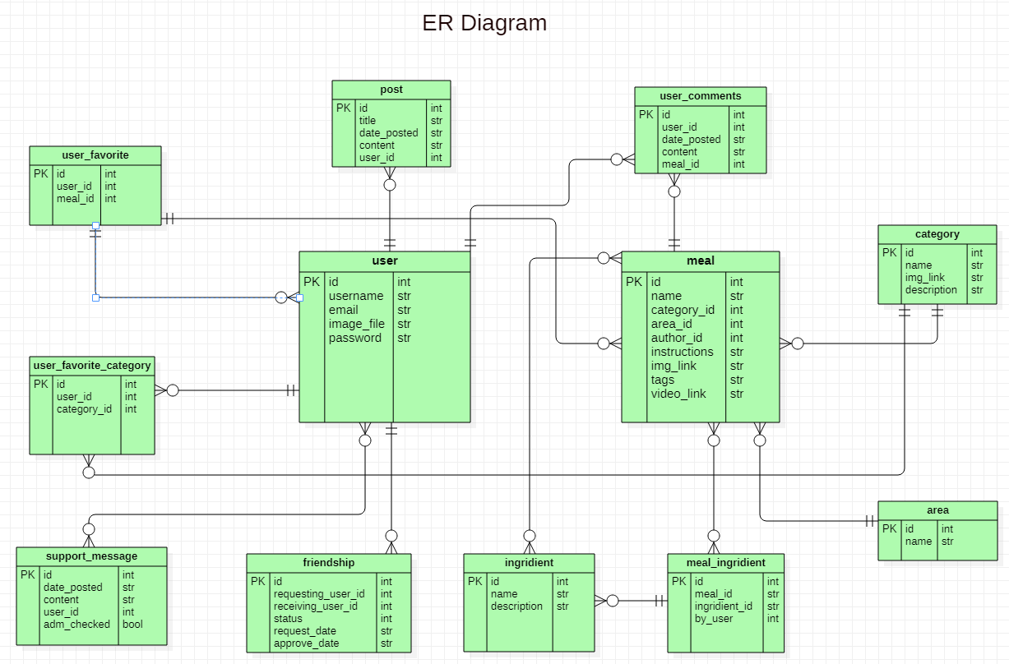
ENTIty relationship diagram
Return to content

Slide 8

Downloading From API
. JSON
request
response
parse
Write .txt
Schedule (24h)
Return to content

Slide 9

FILLING DB
Read_from
db.session.query
db.session.add
Return to content

Slide 10
USERS
users
templates
Account
comments
favourites
friend_request
login
New_receipe
register
scripts
static
Reset_token
Reset_request
user_comment
Update_comment
Support_msg
User_profile
Return to content

Slide 11

USERS preprocessing
forms.py
routes.py
models.py
RegistrationForm
LoginForm
UpdateAccountForm
CommentForm
RequestResetForm
ResetPasswordForm
SupportForm
/register
/login
/logout
/account
/new_recipe
/favourites
/user_profile
/friend-requests
/confirm-friend-request
/add-to-friends
/remove_meal
/update
/delete
/reset_password
/support
into DataBase
Return to content

Slide 12
meals
meals
templates
scripts
static
areas_list
Main_page
Ingridient_info
Category_list
Meal_info
Return to content

Slide 13
Meals preprocessing
routes.py
models.py
fill_db.py
into DataBase
into DataBase
/categories
/areas
/search
/search_by_username
/add-favorite
/meal_info
/ingridient
Return to content

Slide 14
ADMIN PANEL
admin_panel
admin_home
Index_page
templates
Return to content

Slide 15
Admin panel loading …

Slide 16
CHAT
chat
chat
templates
Return to content

Slide 17
Chat loading …

Slide 18
Errors
errors
403
500
templates
static
404
error_main
Return to content

Slide 19
Errors loading …

Slide 20
Index
errors
base
header
templates
static
footer
index_page
Return to content

Slide 21
Index loading …

Slide 22
Mail

